Slide 1
Proving Causality in Social Science: a potential application of ologs
By Noam Angrist

Slide 2

The Goals of Social Science
Explain the world around us. What is really happening and why.
Example: do Kindles boost test scores?

Slide 3
The Goals of Social Science
Did the Kindle intervention work?

Slide 4
What’s Wrong with This?
Some (not all) Key Biases:
(1) Self Selection Bias
(2) Omitted Variable Bias
(3) Attrition Bias
(4) Counterfactual
Rich
Kindle Program
Test Scores

Slide 5
Conventional Methods of Addressing Biases
Add a control group – addresses counterfactual bias

Slide 6
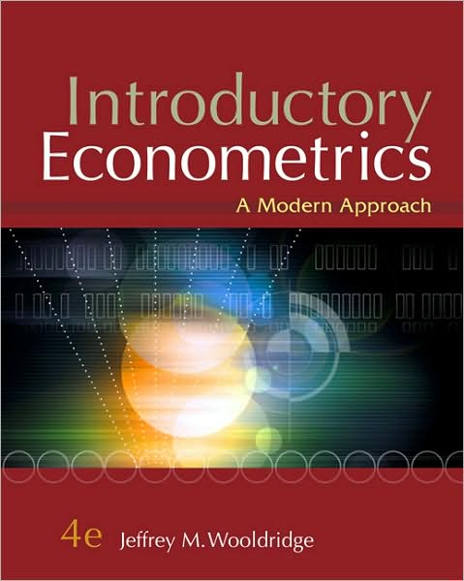
Mathematical-Based Methods of Addressing Biases
Econometrics
Regressions
B) Controlling
C) Instrumental variables
D) Randomized trials
E) Other methods

Slide 7
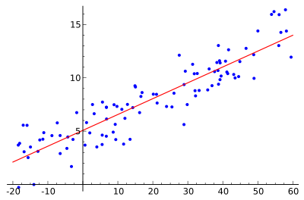
Simple Linear Regression: overview
where
Slope
Residual
Intercept

Slide 8
Simple Linear Regression: derivation
The goal is to minimize the sum of square residuals in order to find the line of best fit:
where
1)
2)

Slide 9
Simple Linear Regression: derivation
1)
2)

Slide 10
Simple Linear Regression: derivation
Plug in alpha from equation (1) into equation (2):
1)
2)

Slide 11
Simple Linear Regression
Intercept
Slope

Slide 12
Simple Linear Regression: An Example
Does a kindle club (as described before) boost test scores?
Let’s find out!
where
Dependent Variable
Independent Variable

Slide 13
Reading Program: test scores
Where:
diff is the difference in test score over 8 weeks
and
Kc is a dummy variable that equals 1 id a student participated in the club and 0 if they didn’t
Thus, we have:
Result:
Participation in the Kindle Club results in an increase of .2134 on standardized test scores relative to all students in the school (everyone else increased around .22 naturally)

Slide 14

Econometrics: controlling
I expand the simple linear regression to include more independent (or predictor) variables:
Multiple regression allows me to control for certain characteristics (i.e. I can determine relationships holding/given certain variables constant).
This takes into account covariance
among variables.
Intuition: conditional probabilities

Slide 15
Reading Program: controlling
I control for (1) income status and (2) grade level:
Result: our estimate for impact of kindle club participation on test score increase relative to the whole school goes up by .04
Explanation 1: free lunch, harder to improve, so had more kids with free lunch such that when we control, we have a higher impact
Explanation 2: higher grade level, less room for improvement since higher baseline so we had more kids at a higher grade level in group

Slide 16
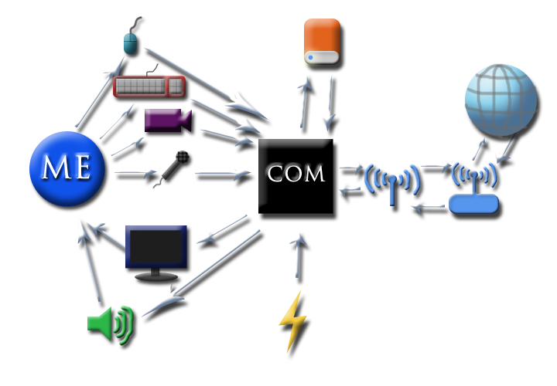
Did it work!?
More issues
Omitted Variable Bias (can’t control for everything) – factors not included in regression which impact independent and dependent variable
Selection Bias
Attrition bias

Slide 17
Econometrics: Instrumental Variables
Birth Date
Gender
Twins
Examples of Z_{i}
Returns of an extra year of schooling
Title IX affect on labor market outcomes
Family size effect on schooling
Causal Outcome

Slide 18
Econometrics: Instrumental Variables
Using a random variable to “instrument” for causality such that Z has no correlation with Y outcome variable, but is highly correlated with X such that you can attribute a causal impact of X on Y
Where
and

Slide 19
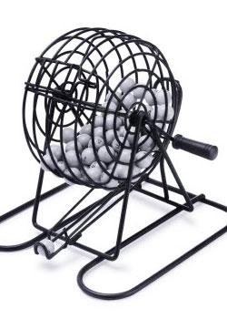
Econometrics: Randomized Trials
Program design: randomly assign treatment and control group (like clinical trials in medicine) – eliminates motivation/demographics biases in intervention
In this case Z_{i} can act as an instrumental variable since our treatment dummy variable is determined by random lottery
Now, β has a casual interpretation, not just correlation

Slide 20
Using Random Assignment for IV approach
Add a random control group – addresses counterfactual bias, omitted variable bias, self-selection

Slide 21
Reading Program: randomized trial
I regress the dummy treatment variable X (1 if randomly selected into the KC, 0 if randomly not selected) on the difference in test scores after 8 weeks
Result: our estimate for impact of kindle club on test score increase is .26 of a reading level (causal since relative to random control group)
Note 1: this is a rigorous result. Also, notice that the regression with controls yields a result closest to the controlled regression
Note 2: it is critical to check for statistical significance
Note 3: measuring intention to treat effect, so underestimate of impact

Slide 22

Is Category Theory Useful for Social Scientists?

Slide 23
So where Does Category Theory Come In?
Defining and determining Omitted Variable Bias through some comprehensive olog
Safe Neighborhood
Rich
Kindle Program
Test Scores

Slide 24
One potential olog: Kindles and Test Scores…which doesn’t work but is useful nonetheless (not functions from sets to sets)
A safe neighborhood
lives in
A person from a wealthy family
has access to
Test preparation
has
Grade Level
can purchase
has access to
Space to study effectively
increases
affects ability to improve
A Kindle
enables students to read
Books
through exposure to reading increases
F&P reading scores
Through more study time increases

Slide 25
A real olog
A pair (u,v) where u and v are distinct students
f
g
A pair of scores (s1, s2) for one test
A pair of scores (s1’, s2’) for one test
The difference
The difference
A number
f: sends v to a bad school without a Kindle; send u to a good school without a Kindle.
g: send v to a bad school with a Kindle; send u to a good school with a Kindle.
Note: choose a global variable which captures effects from other variables

Slide 26
What can I conclude from this olog?
Creating an olog helps the social scientist think through the various processes and factors which might affect our outcomes of interest
There are multiple sources of omitted variable bias
The process of creating an olog helps a scientist determine a comprehensive system which can includes as many factors as the social scientist deems relevant
“A wealthy family” captures many of the omitted variables, seen by the connecting arrows
thus controlling for having a wealthy family should yield estimates close to those causal estimated using a randomized controlled trial

Slide 27
Reading Program: controlling
I control for (1) income status and (2) grade level:

Slide 28
Instrumental variables application using Ologgy-like stuff (another broken but useful olog)
Z
A person in a wealthy family
Twins
has access to
can afford going to
Birth control
increase
influences
A type of school
yields
Family Size
education level of a child
through dividing up resources per child affects
X
Y

Slide 29
Conclusion
If we design ologs before our analysis phase we can make sure that:
(1) we come up with credible instrumental variables
(2) when we control for all relevant variables that might have otherwise been omitted and determine which variables can proxy for others
This is important because:
Randomized trials are expensive and we often resort to controlling as an alternative option to determine causal relationships
In the absence of randomized trials, we also need good instruments to determine causal relationships

Slide 30

Questions/Comments

